Slide 1
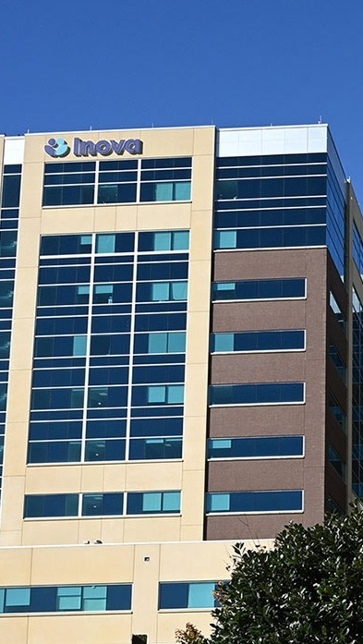


OPPORTUNITY REVIEW
DIRECT-TO-EMPLOYER GTM STRATEGY
Exploring a Inova DTE Health Plan

Slide 2


Founded in 1979, headquartered in Indianapolis
Largest Independently-Owned Full-Service Third-Party Administrator
Specialize in Administration of Self-Funded Plans and Population Health Management​
Leader in the Direct-to-Employer Movement
We Know and Understand the Market
Experience Working with All Professional Teams: Agents, Networks, MGAs
The Key Family of Companies is a Vertically Integrated group of benefit related organizations
3,000+ Corporate Clients
3 Million Members under Management
700 Employees

Slide 3
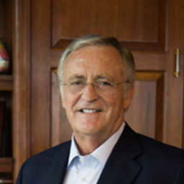


Our Founding and Heritage: 46 Years of Striving for Honesty in Healthcare

Slide 4
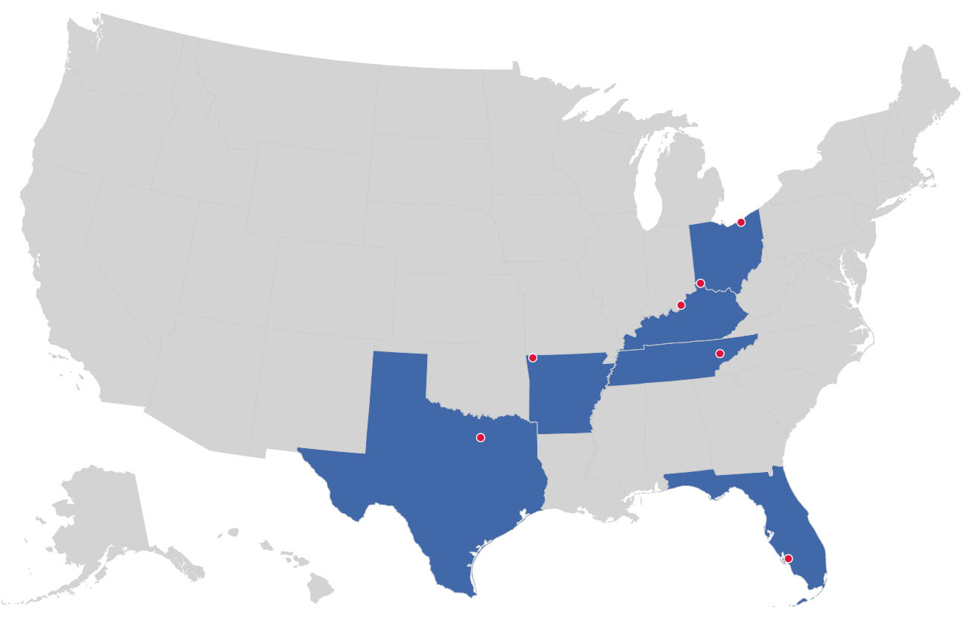

MARKET LEADER
IN
PRIVATE LABELED
DTE PLANS
Cleveland, OH
Louisville, KY
Cincinnati, OH
Bentonville, AR
Knoxville, TN
Dallas Fort Worth, TX
Fort Myers, FL

Slide 5


DIRECT-TO-EMPLOYER (DTE)
YOU Pick the Name of the Health Plan
YOU Determine the Fees Charged
YOU Practice the Medicine
YOU Receive the Profits
WE Make it Successful
Your Health Plan Focused on a Direct Relationship with Self-Funded Employers in Your Market

Slide 6
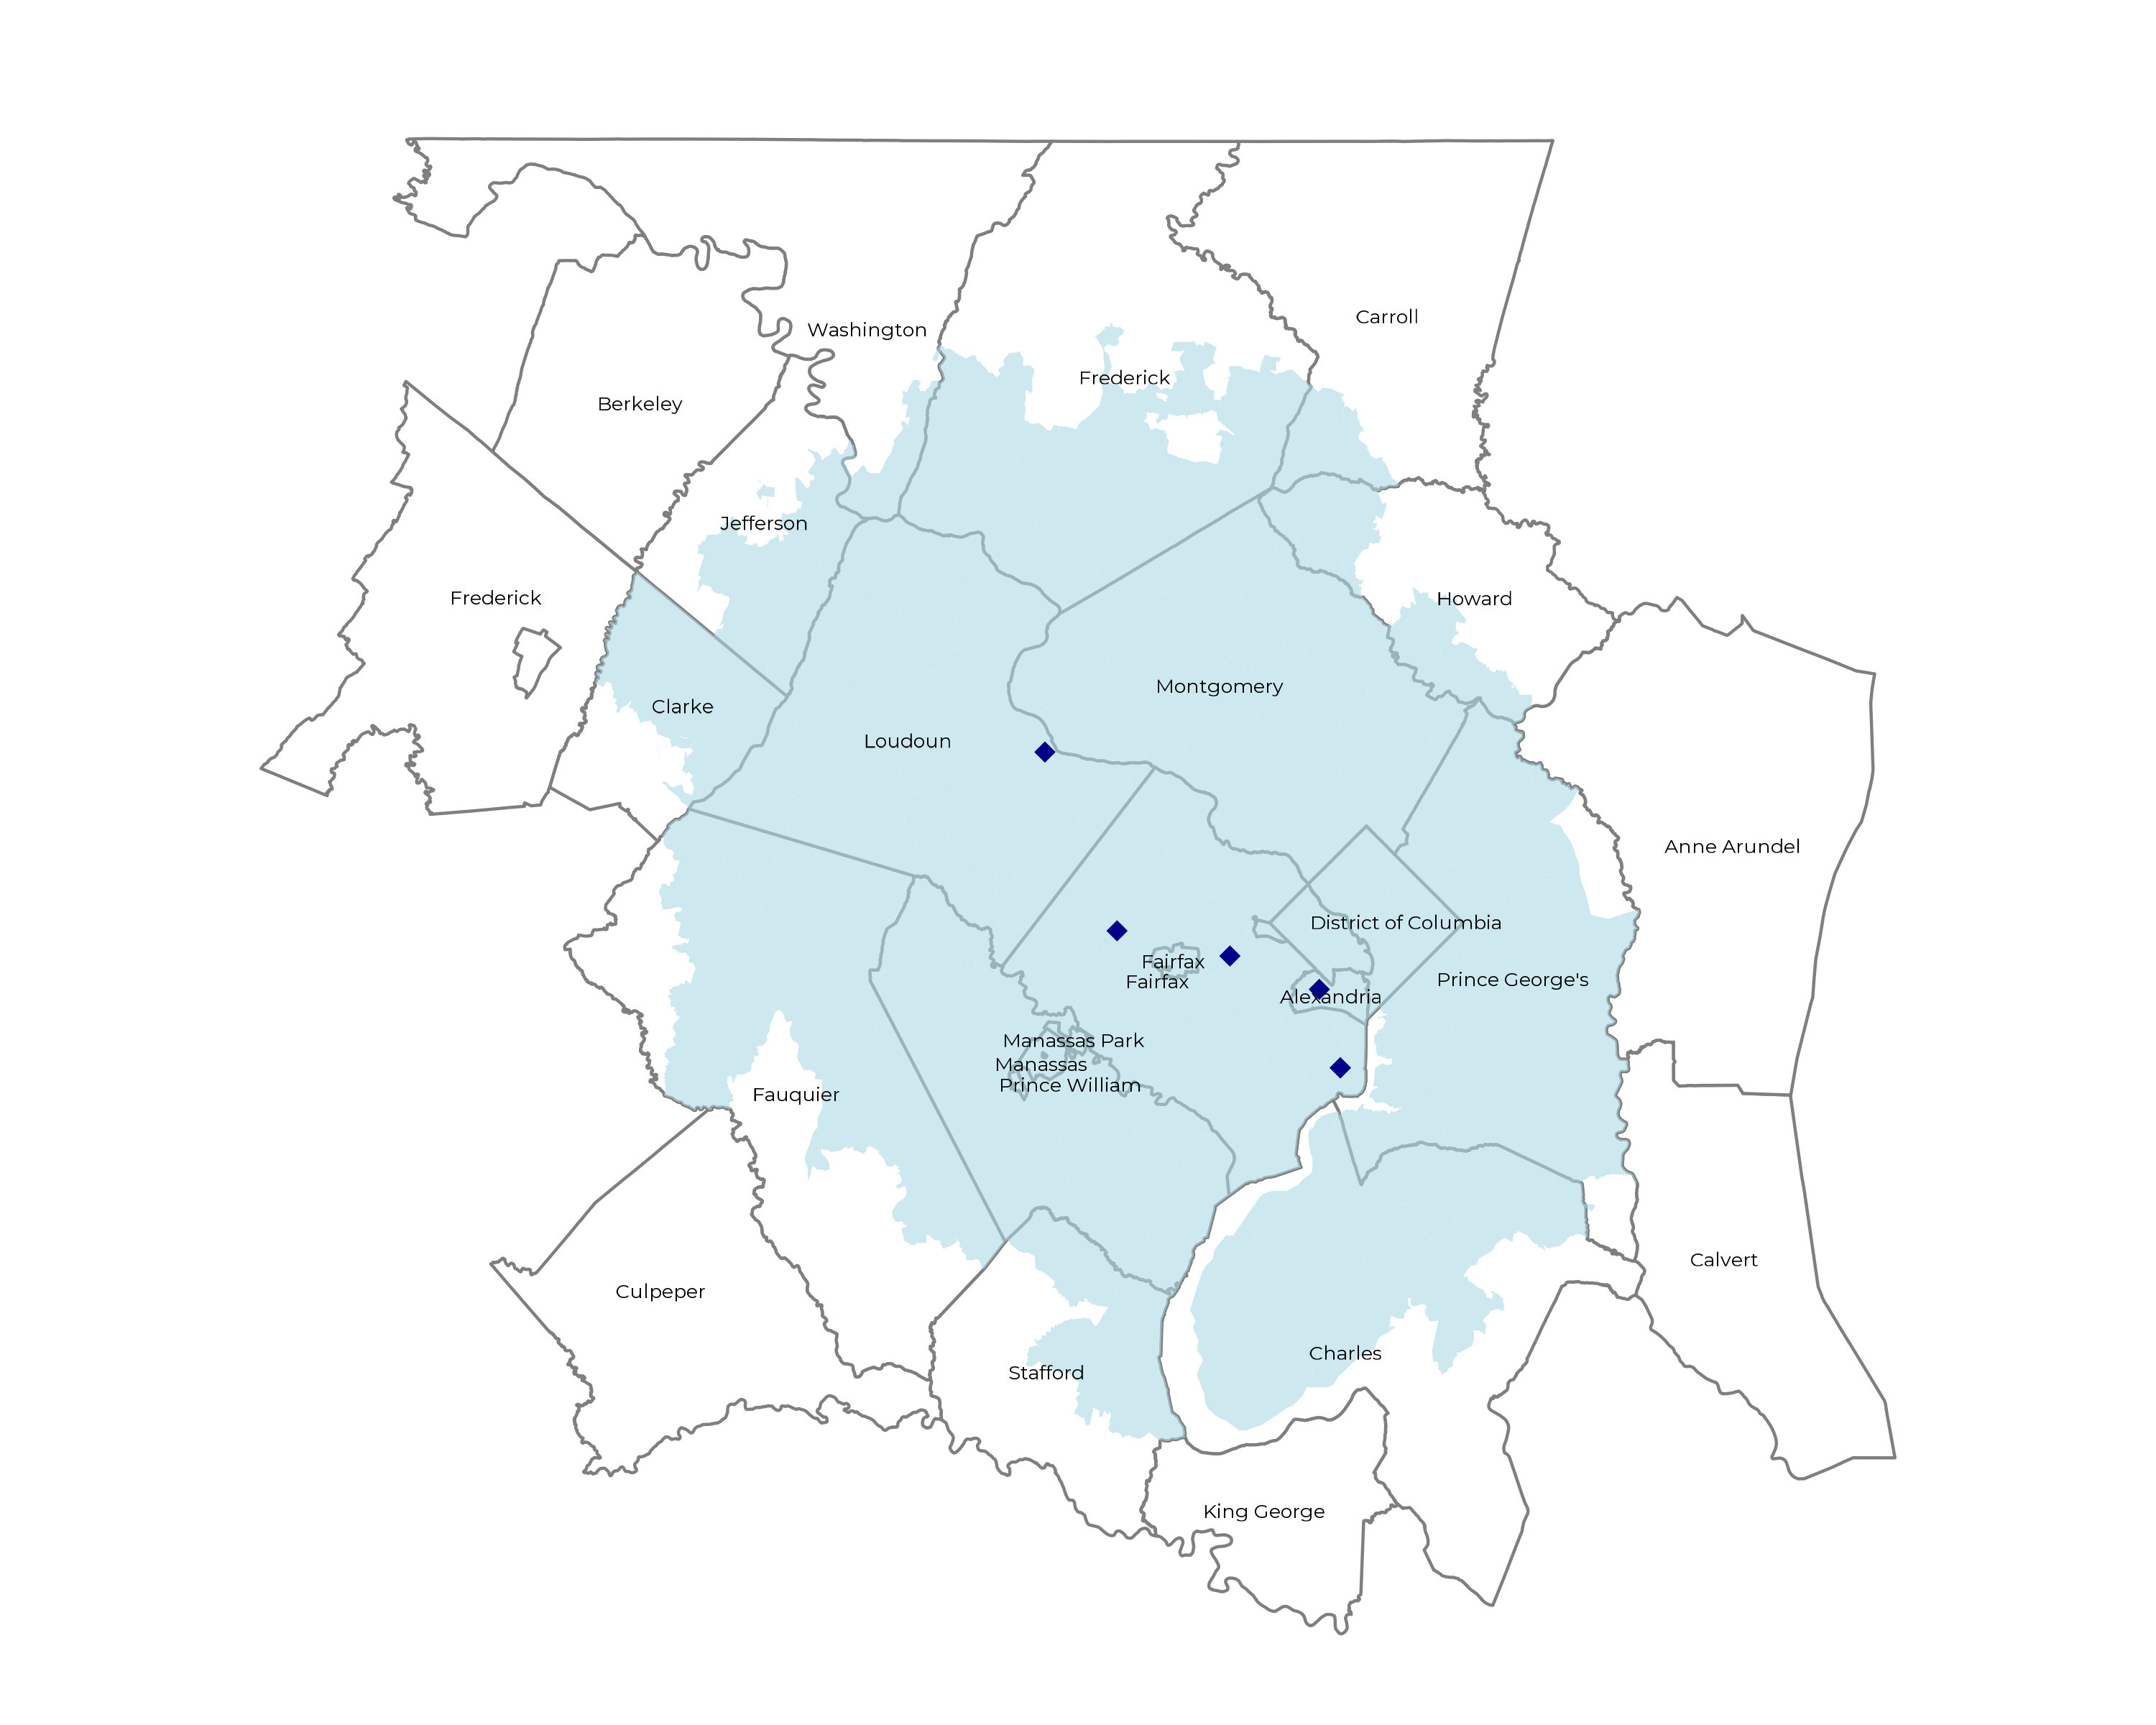
SIGNIFICANT OPPORTUNITY FOR PLAN GROWTH Researched for the below highlighted service area
Target Market 12,000+ Employers 2,100,000+ Employees 3,800,000+ Members
 | Employer Size Group (# of Employees)
Commercial Employers With Headquarters | 50-100 | 101-200 | 201-400 | 401-1,000 | 1,001-3,000 | 3,000+
In Catchment Area | 6,354 | 2,920 | 1,816 | 996 | 365 | 239
Total Employees at Employers | 50-100 | 101-200 | 201-400 | 401-1,000 | 1,001-3,000 | 3,000+
Headquartered in Catchment Area | 476,600 | 438,000 | 544,800 | 697,200 | 730,000 | 1,434,000
Total Members with Employers | 50-100 | 101-200 | 201-400 | 401-1,000 | 1,001-3,000 | 3,000+
Headquartered in Catchment Area | 857,900 | 788,400 | 980,600 | 1,255,000 | 1,314,000 | 2,581,200

Slide 7
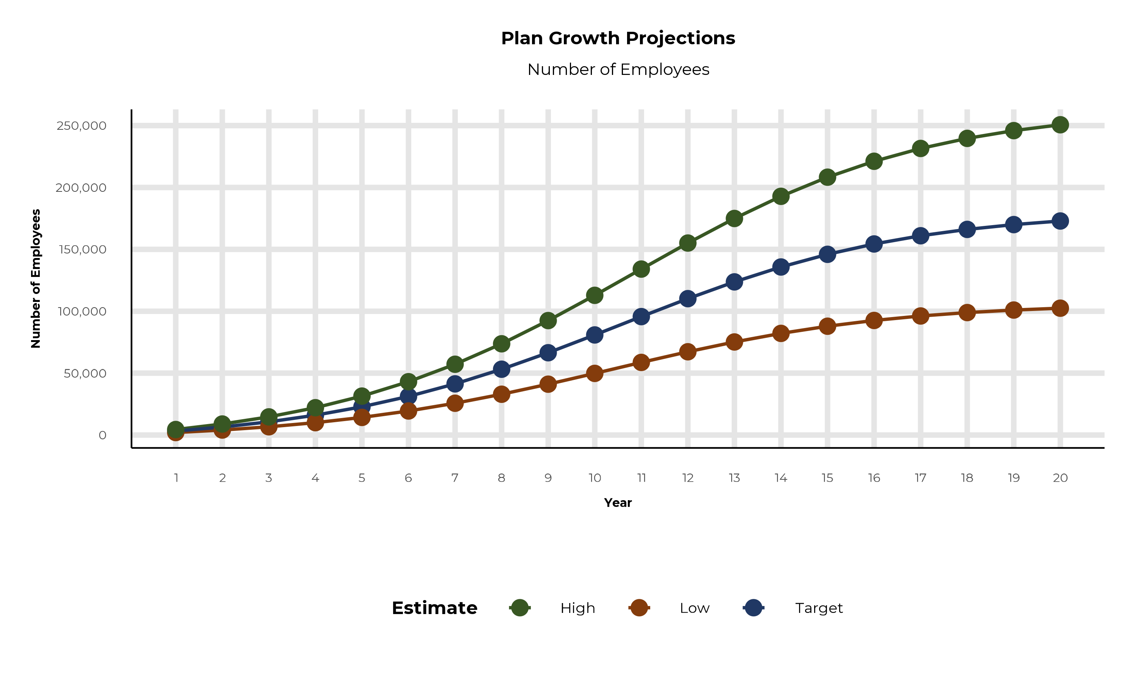
PLAN POTENTIAL GROWTH PATHS
Self Funded
1,185K
Insured
2,294K
Working Age
3,004K
Population
4,943K
Estimates includes the Inova service area in Charles, Frederick, Howard, Montgomery, Prince George's, Washington, Arlington, Clarke, Fairfax, Fauquier, Loudoun, Prince William, Stafford, Alexandria, Falls Church, Manassas, and Jefferson Counties

Slide 8
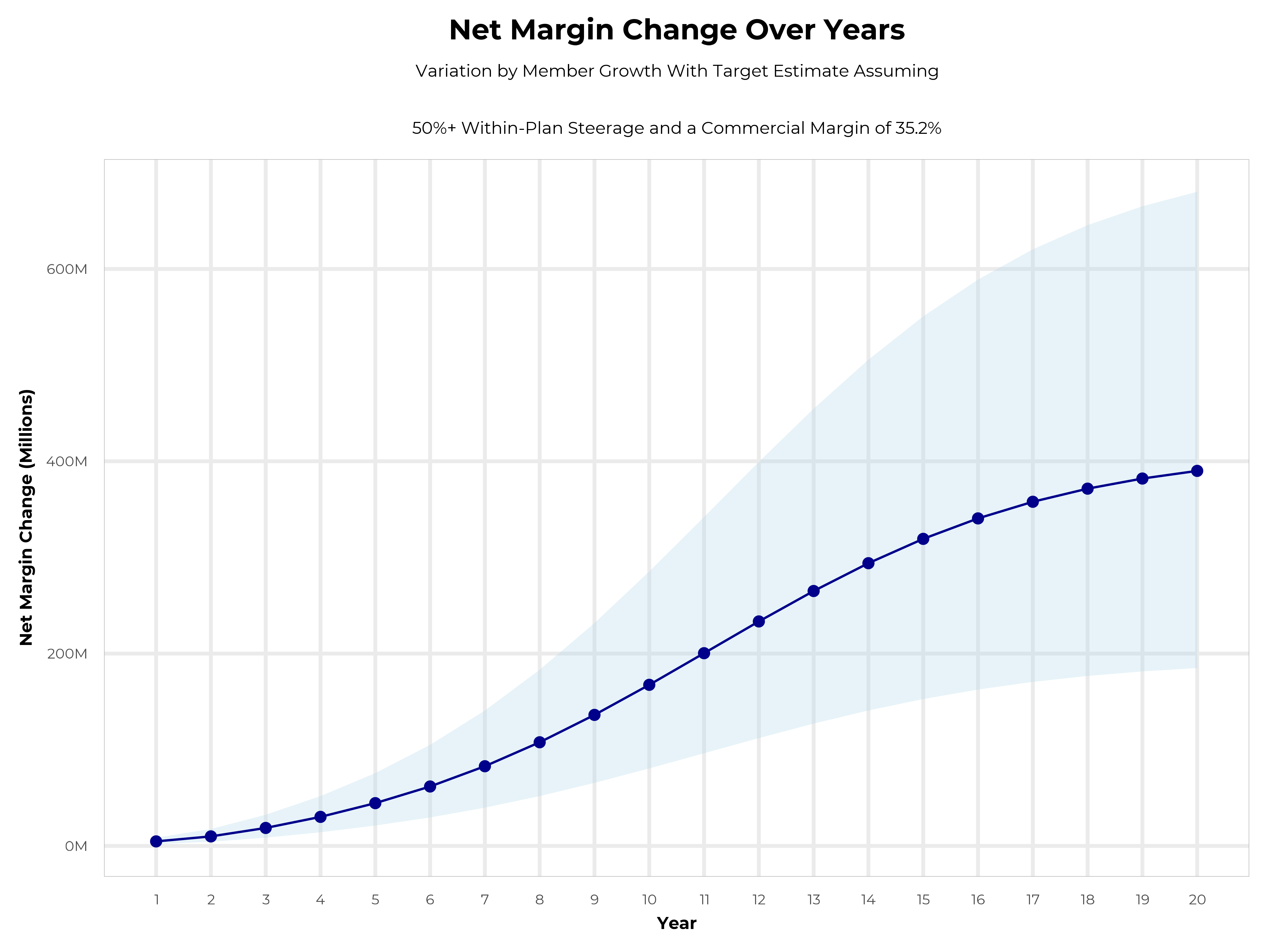
GROWING POWERFUL, LASTING PROFITABILITY
Early Stage
Gaining Name Recognition, Early Growth
New Revenue:
New Profit:
$79.97M
$28.3M
Growth Stage
Strong Reputation, Strong Growth
New Revenue:
New Profit:
$479.28M
$170.49M
Mature Stage
High Profitability, Market Saturation
New Revenue:
New Profit:
$986.23M
$350.77M

Slide 9
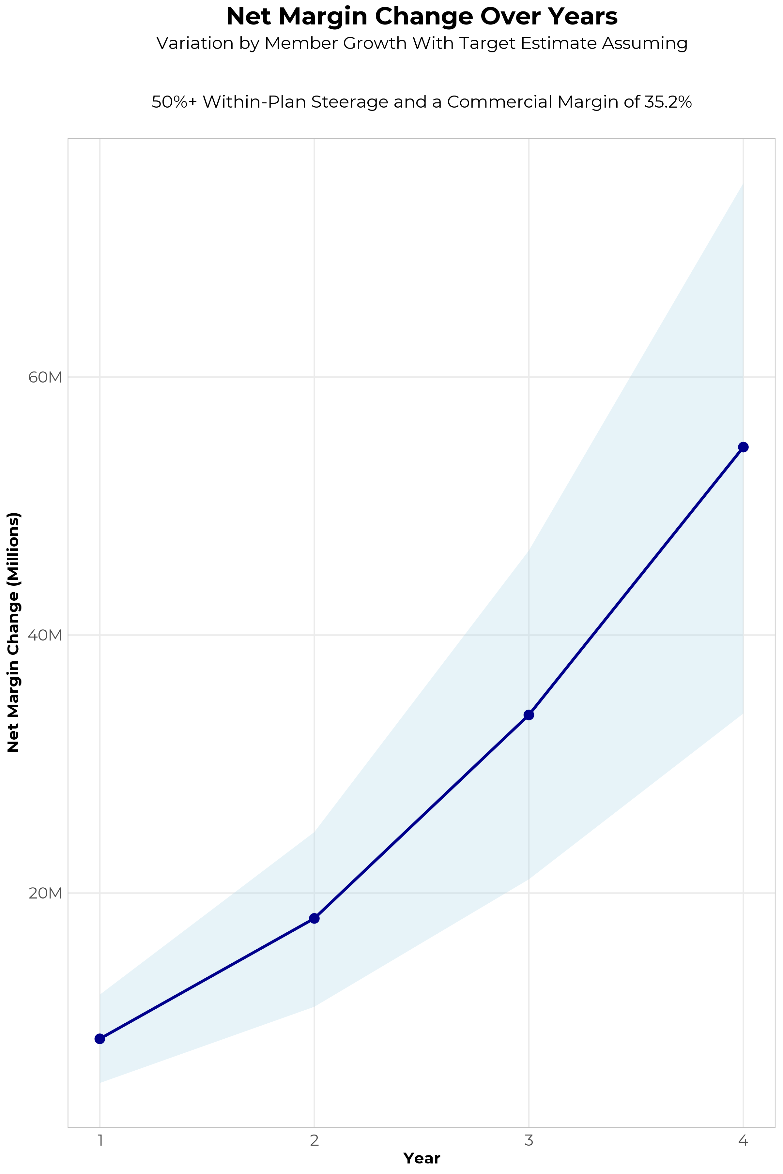
FOUR-YEAR PROJECTIONS
Target Member Growth | Target Member Growth | Target Member Growth | Target Member Growth | Target Member Growth
Metric | Year 1 | Year 2 | Year 3 | Year 4
Number of Members | 5,800 | 11,700 | 19,200 | 28,900
Incremental Margin | 8,959.6K | 18,073.7K | 33,757.5K | 54,404.9K
Network Access Fee | 69.6K | 140.4K | 230.4K | 346.8K
Implementation Fee (One-Time) | -150.0K | 0.0K | 0.0K | 0.0K
Sales and Marketing Costs | -180.0K | -180.0K | -180.0K | -180.0K
Net Margin Change | 8,699.2K | 18,034.1K | 33,807.9K | 54,571.7K
High Member Growth | High Member Growth | High Member Growth | High Member Growth | High Member Growth
Metric | Year 1 | Year 2 | Year 3 | Year 4
Number of Members | 8,000 | 16,000 | 26,400 | 39,700
Incremental Margin | 12,358.1K | 24,716.2K | 46,416.6K | 74,736.2K
Network Access Fee | 96.0K | 192.0K | 316.8K | 476.4K
Implementation Fee (One-Time) | -150.0K | 0.0K | 0.0K | 0.0K
Sales and Marketing Costs | -180.0K | -180.0K | -180.0K | -180.0K
Net Margin Change | 12,124.1K | 24,728.2K | 46,553.4K | 75,032.6K
Low Member Growth | Low Member Growth | Low Member Growth | Low Member Growth | Low Member Growth
Metric | Year 1 | Year 2 | Year 3 | Year 4
Number of Members | 3,600 | 7,300 | 12,000 | 18,000
Incremental Margin | 5,561.1K | 11,276.8K | 21,098.5K | 33,885.4K
Network Access Fee | 43.2K | 87.6K | 144.0K | 216.0K
Implementation Fee (One-Time) | -150.0K | 0.0K | 0.0K | 0.0K
Sales and Marketing Costs | -180.0K | -180.0K | -180.0K | -180.0K
Net Margin Change | 5,274.3K | 11,184.4K | 21,062.5K | 33,921.4K

Slide 10
DIRECT-TO-EMPLOYER STRATEGY: ONLY AVAILABLE TO PREMIER HEALTH SYSTEMS
STRONG Brand Quality
EXTENSIVE Patient Access
AFFORDABLE Value Pricing
EXCELLENT Care Quality

Slide 11
INOVA IS PATIENT RECOMMENDED
Health System | HCAHPS Recommendation Percentile | CMS Stars Percentile | Mortality Percentile | Readmission Percentile | KBA Brand Quality Score
VHC Health | 75 | 100 | 76 | 69 | 71
Inova | 75 | 96 | 71 | 62 | 69
Johns Hopkins Medicine | 64 | 63 | 70 | 57 | 68
HCA Healthcare | 46 | 63 | 88 | 55 | 60
Adventist HealthCare (MD) | 34 | 24 | 66 | 45 | 57
UVA Health System | 37 | 90 | 77 | 60 | 56
MedStar Health | 25 | 60 | 74 | 61 | 53
Department of Veterans Affairs | 24 | 63 | 77 | 57 | 53
Frederick Health Hospital | 18 | 63 | 59 | 74 | 51
Sentara Health | 18 | 63 | 67 | 43 | 51
Trinity Health | 17 | 31 | 75 | 53 | 50
Universal Health Services | 16 | 8 | 72 | 57 | 49
Luminis Health | 10 | 31 | 61 | 64 | 48
Based on quality measures and HCAHPS feedback, KBA estimates that Inova has the strongest brand quality in Charles, Frederick, Howard, Montgomery, Prince George's, Washington, Arlington, Clarke, Fairfax, Fauquier, Loudoun, Prince William, Stafford, Alexandria, Falls Church, Manassas, and Jefferson Counties.

Slide 12
The Key Incentive Plan
Base Medical + Preferred Plus Benefits = Your Deductible Can Simply Vanish
Example: Member with a $2,500 deductible / $4,500 max out-of-pocket has a heart attack and cardiac surgery, resulting in a 5-day in-patient stay. In this example, the member would have a $4,500 OOP with $5,050 Preferred Plus Benefits for a net OOP $0 due to the preferred provider versus $4,500 OOP exposure at any non-preferred provider.
BASE MEDICAL BENEFITS* |  |  | PREFERRED PLUS BENEFITS
Deductible |  |  | Benefits automatically included in your plan!
Single | $2,500 |  |  | Preferred Provider | Non-Preferred Provider
Family | $4,500 |  | OP Radiology/X-Ray | $200 | $0
Coinsurance |  |  | OP Diagnostic Labs | $100 | $0
80% / 20% |  |  | Preferred Hospital Stay ($500/day, 5 days) | $2,500 | $0
Maximum Out-of-Pocket |  |  | Critical Illness Benefit | $2,000 | $0
Single | $4,500 |  | Health Screening Benefit | $125 | $0
Family | $9,000 |  | Total Employee OOP | $4,500 | $4,500
Chronic Disease Management Regimens of Care Covered at 100% |  |  | Preferred Plus Benefits | $4,925 | $0
Healthcare Convience Card to Cover Out-of-Pocket Expenses at 0% interest |  |  | Employee Amount Due to Provider | $0 | $4,500
Health Guardian Account to help members manage their healthcare expenses at Preferred Providers |  |  | Additional Benefit Payable to the Health Guardian Account | $425 | $0
*Base Medical Benefits are for illustration purposes only. Base benefits can be customized to meet client needs.

Slide 13

THE BENEFIT STEERING THE PATIENT TO INOVA
What Will this Claim Cost Me?
Explanation of Benefits
Heart Attack, Cardiac Surgery
THE CHARGES
Medical Bills | $25,000
Healthcare out-of-pocket due to provider | $4,500
Since your out of pocket maximum has been met, the rest of your eligible charges this year will be paid at 100%
THE CREDITS
OP Radiology/X-Ray | $200
OP Diagnostic Labs | $100
Preferred Hospital Stay ($500/day, 5 days) | $2,500
Critical Illness Benefit | $2,000
Health Screening Benefit | $125
Benefit Total | $4,925
Out of Pocket Paid to Hospital | ($4,500)
Balance Paid to HSA | $425
Inova patients can have all out-of-pocket liability reduced to $0!

Slide 14
PROJECTED PLAN GROWTH
Year | Employees | Members | Percent of Members Choosing Inova for Inpatient Care | Percent of Members Choosing Inova for Outpatient Care
1 | 3,200 | 5,800 | 60% | 50%
2 | 6,500 | 11,700 | 60% | 50%
3 | 10,700 | 19,300 | 65% | 55%
4 | 16,000 | 28,800 | 67% | 58%
5 | 22,800 | 41,000 | 68% | 60%
6 | 31,200 | 56,200 | 68% | 60%
7 | 41,300 | 74,300 | 69% | 61%
8 | 53,200 | 95,800 | 69% | 62%
9 | 66,500 | 119,700 | 69% | 62%
10 | 80,900 | 145,600 | 70% | 63%
11 | 95,700 | 172,300 | 70% | 63%
12 | 110,200 | 198,400 | 70% | 64%
13 | 123,700 | 222,700 | 71% | 64%
14 | 135,800 | 244,400 | 71% | 65%
15 | 146,000 | 262,800 | 71% | 66%
16 | 154,400 | 277,900 | 72% | 66%
17 | 161,000 | 289,800 | 72% | 66%
18 | 166,100 | 299,000 | 72% | 67%
19 | 170,000 | 306,000 | 72% | 67%
20 | 172,900 | 311,200 | 72% | 67%
KBA currently estimates that Inova has 24% inpatient market share, and 16% outpatient market compared to hospitals/clinics in the Inova service area (see slide 8).
Based on previous DTE experience, KBA expects a significant bump in patient steerage to Inova.
Additional steerage will occur from additional steerage patient benefits and the patient convenience card.
High estimates start nearly 10% higher than target with low estimates at 10% lower than target

Slide 15
YEAR 4 PROJECTED REVENUE AND PROFIT
Pre-DTE Cohort of 28,900 Employees | Inpatient | Outpatient | Professional | Total
Revenue† | $ 23,216,209 | $ 27,949,827 | $ 13,052,332 | $ 64,218,367
Net Income‡ | $ 8,172,106 | $ 9,838,339 | $ 4,594,421 | $ 22,604,865
† Assuming proportional revenues from market shares of 24% (inpatient) and 16% (outpatient)
‡ Conservatively assuming a commercial margin of 35.2% (80% of the estimated commercial margin)
With DTE | Inpatient | Outpatient | Professional | Total
Revenue⁰ | $ 65,987,968 | $ 103,480,235 | $ 48,324,390 | $ 217,792,593
Net Income* | $ 23,227,765 | $ 36,425,043 | $ 17,010,185 | $ 76,662,993
⁰ Assuming 67% inpatient and 58% market steerage based on KBA narrow network DTE experience (see previous slide)
* Conservatively assuming a commercial margin of 35.2%, with a 10 percentage-point reduction to reflect competitive-edge rates and a 10 percentage-point increase due to lower billing costs and higher patient responsibility collections because of the member convenience card.
Total Increase in Net Income | $ 54,058,128
Network Access Fee (Revenue) of $1 PMPM | $ 346,800
Total Profit Growth | $ 54,404,928
Minus Implementation Fee (One-Time) | -$ 0
Minus Sales and Marketing (Annual – Ongoing) | -$ 180,000
Total | $ 54,224,928

Slide 16





A PARTNER YOU CAN TRUST
OUR OBJECTIVES ARE ALIGNED
WE KNOW THE
MARKET
COMPLETELY TRANSPARENT
WE HAVE THE SOPHISTICATION AND INFRASTRUCTURE TO EFFECTIVELY COMPETE
Derek Moore, Senior Vice President – KBA
845-283-9973 * derek.moore@keybenefit.com

